Slide 1

Thank you for utilizing the AMQ Furniture Budget Estimator.
This PowerPoint allows you to customize your furniture estimate file in three easy steps:
Edit the following slides of this PowerPoint to include your project name, your head shot, your introduction letter, and your floorplan in the places that are setup for those items, deleting anything you may not need (including this slide!)
Save this PowerPoint as a PDF
Upload the PDF file to the Furniture Budget Estimator where shown, and it will generate a new PDF with the application thought starters and your custom PDF as a final file
DELETE THIS SLIDE
AMQ Budget Estimator

Slide 2
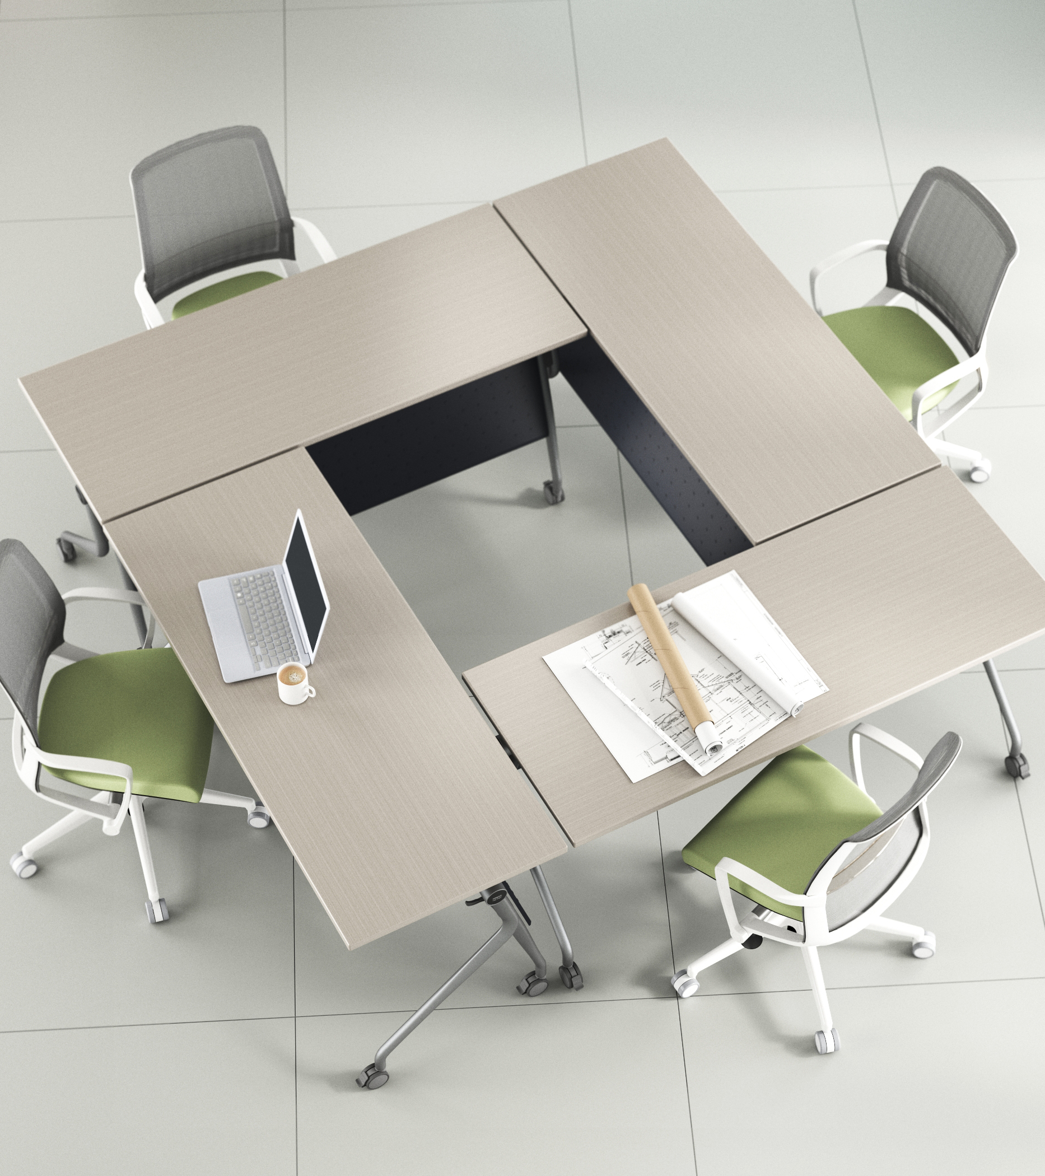
AMQ Furniture Budget Estimator
Project Name:
Furniture Budget Estimate:
Date:
AMQ Budget Estimator

Slide 3
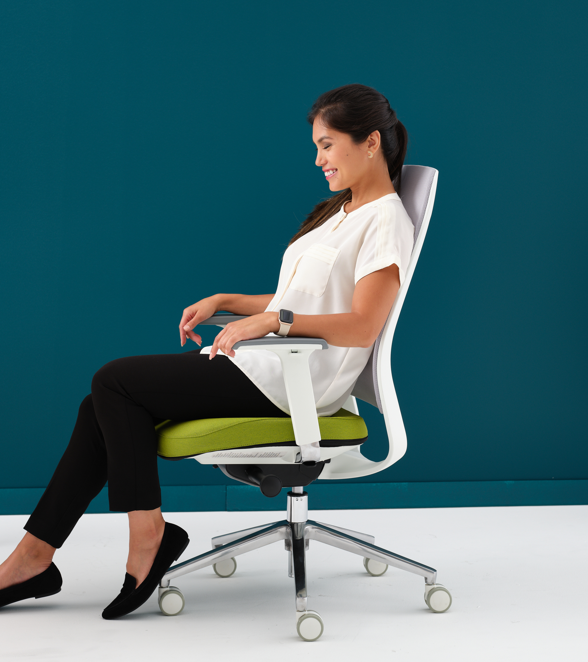
AMQ Furniture Budget Estimator
Insert BIO Pic
Thank you for the opportunity to partner with PROJECT NAME.
The following AMQ furniture package includes a rough initial budget and financing information based on the floor plan.
I look forward to exploring these applications and work concepts with you.
NAME
Position
CONTENTS:
Furniture Budget Summary
Floorplan Overview
Application Thought Starters
Financing
AMQ Budget Estimator

Slide 4
Floorplan Overview
AMQ Furniture Budget Estimator

Slide 5
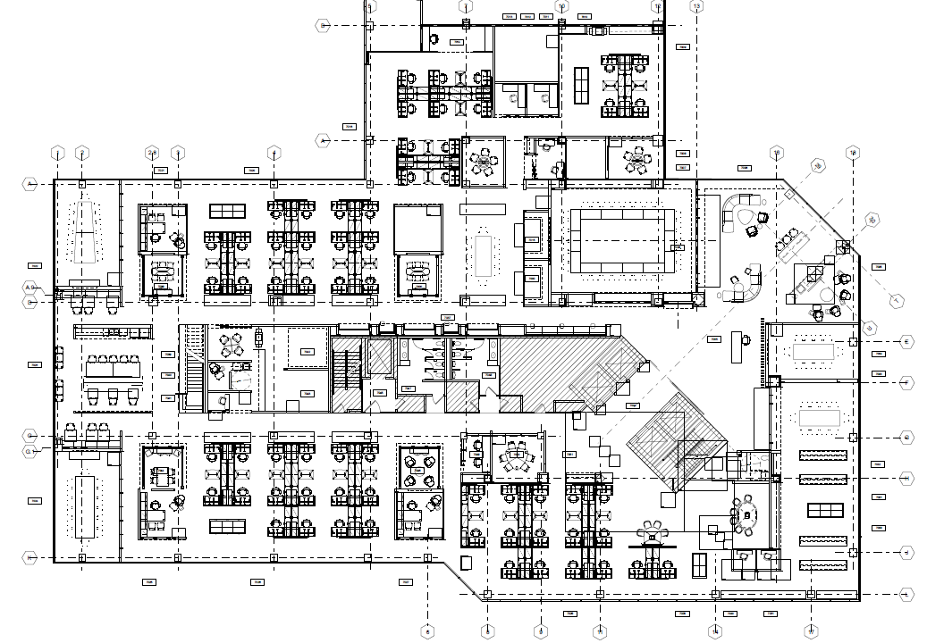
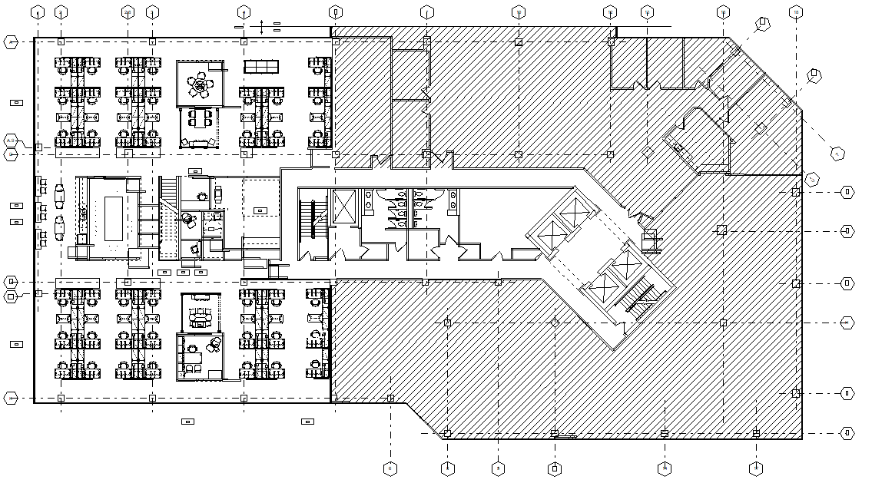
Floorplan Overview
Include Floorplan provided
Included Square Footage
AMQ Budget Estimator

Slide 6
Floorplan Overview
Update with Floorplan provided and updated colored squares
Space Classification
Space Classification for Budget Calculation
INDIVIDUAL SPACES
Bench (4 pack)
Height Adjustable Bench (4 pack) Panel Based Workstation (4 pack)
Height Adjustable Panel Based Workstation (4 pack) 120 Degree Workstation (Group of 3)
Private Office
Qty
0
0
0
26
0
5
COMMUNITY SPACES
Respite Room
Neighborhood Café (16 people) Training Room (16 people) Filing Cabinets
Qty
2
2
2
34/34
SEATING
Task Chair Guest Chair
Reception Seating
Qty
0
10
5
COLLABORATIVE SPACES
Enclave (1 person)
Extra Small Conference Room (2 people) Small Conference Room (4 people) Large Conference room (10 people) Open Collaboration (4 people)
Qty
11
1/1
5/5
3/6
7/8
INTEGRATED TECHNOLOGY
Conference Room Reservation System media:scape
Qty
3/7
3
AMQ Budget Estimator

Slide 7
Floorplan Overview
Update with Floorplan provided and updated colored squares
Space Classification
Space Classification for Budget Calculation
INDIVIDUAL SPACES
Bench (4 pack)
Height Adjustable Bench (4 pack) Panel Based Workstation (4 pack)
Height Adjustable Panel Based Workstation (4 pack) 120 Degree Workstation (Group of 3)
Private Office
Qty
0
0
0
26
0
5
COMMUNITY SPACES
Respite Room
Neighborhood Café (16 people) Training Room (16 people) Filing Cabinets
Qty
2
2
2
34/34
SEATING
Task Chair Guest Chair
Reception Seating
Qty
0
10
5
COLLABORATIVE SPACES
Enclave (1 person)
Extra Small Conference Room (2 people) Small Conference Room (4 people) Large Conference room (10 people) Open Collaboration (4 people)
Qty
11
1/1
5/5
3/6
7/8
INTEGRATED TECHNOLOGY
Conference Room Reservation System media:scape
Qty
3/7
3
AMQ Budget Estimator

